Slide 1
45-952 ETE Analytics
Final Presentation
PT Team 2
Amira Roux and Luke Profio

Slide 2
Summary of our method & Final Graphs:
1. Summary Graphs:
- Generated summary graphs, including barplots and correlation heatmaps, to provide a concise visual overview of the dataset.
2. Model Performance Graphs:
- Presented ROC curves with AUC values to showcase the performance of both logistic regression and decision tree models.
Notes:
1. Summary Graphs:
- To effectively communicate the intricacies of the dataset, we generated various summary graphs that highlight key aspects and relationships within the data. These graphical representations include barplots, which illustrate the distribution of categorical variables by depicting their frequencies, as well as correlation heatmaps that display potential connections between different numerical variables. Utilizing these visual tools allows for a faster and more comprehensive understanding of the dataset’s inherent properties while also serving as a basis for further analysis.
2. Model Performance Graphs:
- In order to evaluate and present the effectiveness of our chosen predictive models, namely logistic regression and decision tree models, we employed Receiver Operating Characteristic (ROC) curves accompanied by corresponding Area Under Curve (AUC) values. The ROC curves show the trade-off between true positive rates (sensitivity) and false positive rates (1-specificity) at varying classification thresholds, thereby facilitating optimal model evaluation and comparison. With this visual representation, we can determine how well the models distinguish between distinct classes or outcomes and select the most suitable one based on its AUC value – a reliable indicator of overall classification performance.

Slide 3
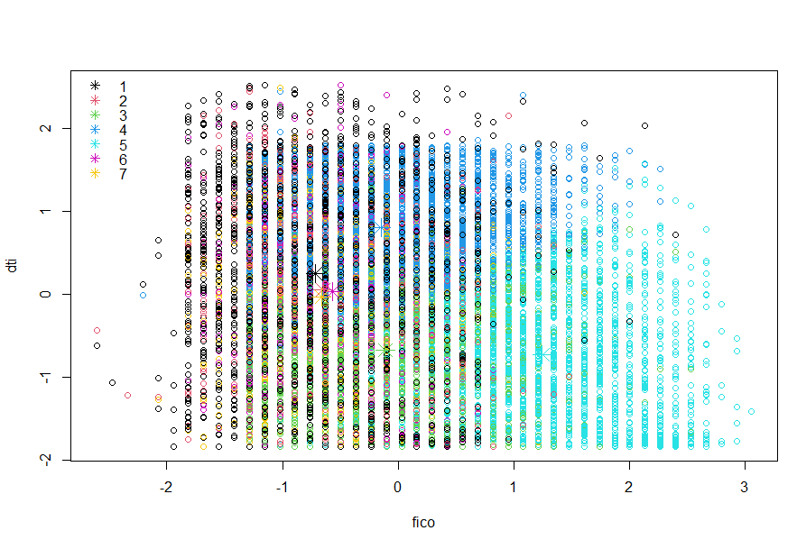
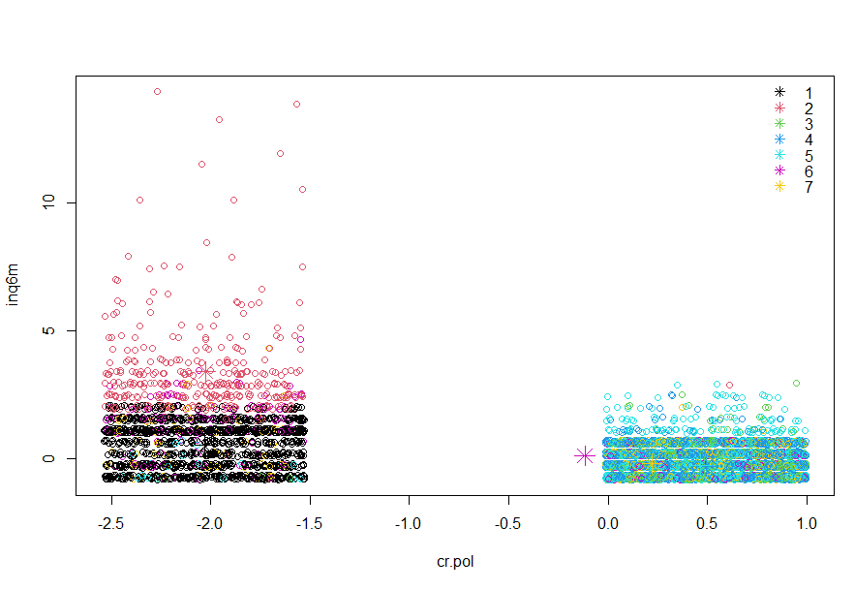
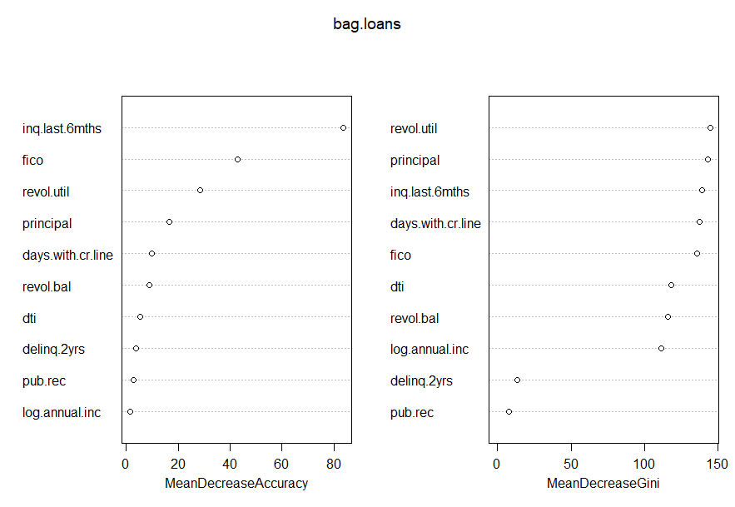
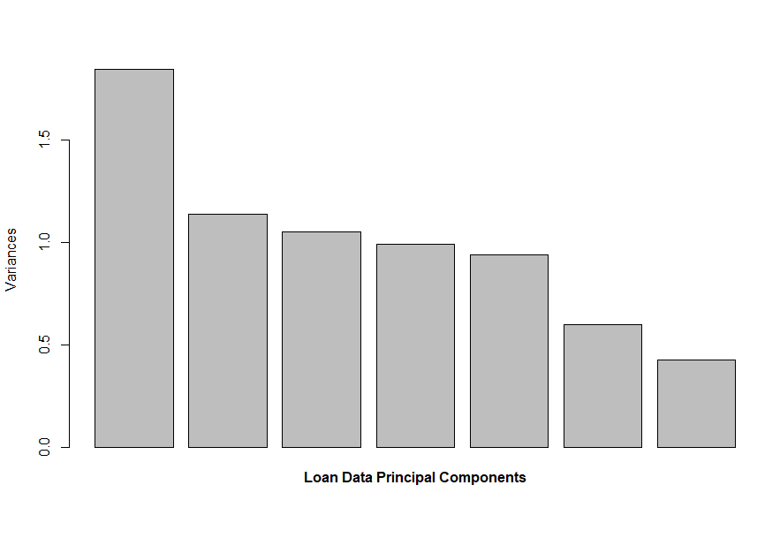
Summary of our Graphs
Notes:
As demonstrated in the graphs above, we have conducted a comprehensive analysis of the loan dataset using principal component analysis (PCA) on credit policy (Cr.pol) loan data. From the data provided, we successfully extracted relevant insights by exploring the principal components and their relationships.
In summary, the main findings from the various graphs are as follows:
1. The distribution of loans across different credit policies: The graph displays a comparison between approved and rejected loans based on their credit policies, allowing us to identify any potential patterns or trends.
2. Correlation between principal components: A correlation matrix offers us a clear visualization of how each principal component is related to others. This enables us to detect any strong correlations or potential multicollinearity among components.
3. Scree plot for explained variance: By plotting the cumulative explained variance against the number of components, we determine the optimal number of principal components to include in our analysis that efficiently captures the majority of variance in the dataset.
4. Biplot illustrating variable loadings and component scores: The biplot allows us to observe both component loading's and individual datapoint's projection on the principal component plane. This provides insight into how each variable contributes to each component while also showcasing relationships among datapoints.
Overall, by examining these graphs collectively, we have gained a thorough understanding of the loan dataset's underlying structure and associations among its variables. This information enables decision-makers to identify key drivers of loan performance and implement effective strategies based on data-driven insights.

Slide 4
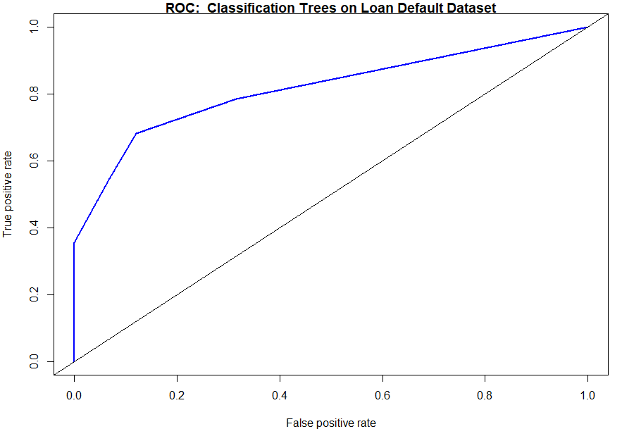
Logistic Regression Modeling:
1. Variable Selection:
- Logistic regression models were built to predict loan defaults.
- Significant predictors were identified based on p-values.
- Variable selection was performed by excluding correlated variables and using stepwise regression.
2. Model Evaluation:
- The performance of the logistic regression model was evaluated using ROC curves and the Area Under Curve (AUC).
3. Visualization of Model Response:
- The impact of variables on the probability of default was visualized using the plotmo package.
Notes:
logistic regression models were constructed to predict the likelihood of loan defaults. These models utilized different predictor variables, which were determined to be significant based on their p-values. To enhance the accuracy and efficiency of these models, a variable selection process was implemented. This involved excluding variables that were highly correlated with one another and employing stepwise regression to choose the most relevant predictors.
After constructing the logistic regression models, their performance was assessed by generating Receiver Operating Characteristic (ROC) curves and examining the Area Under Curve (AUC) values. ROC curves outline the true positive rate (sensitivity) against the false positive rate (1 - specificity), depicting the trade-off between sensitivity and specificity. A higher AUC value indicates a better-performing model with a superior ability to differentiate between defaulters and non-defaulters.
To visualize the impact of individual variables on the probability of loan defaults, the plotmo package was utilized. This tool creates graphs that illustrate how specific predictors contribute to the overall model response – in this case, the likelihood of default. By assessing these visualizations, researchers can more clearly understand how each predictor variable influences the model's prediction ability, enabling them to make informed decisions on incorporating or excluding specific variables in their final predictive model.

Slide 5
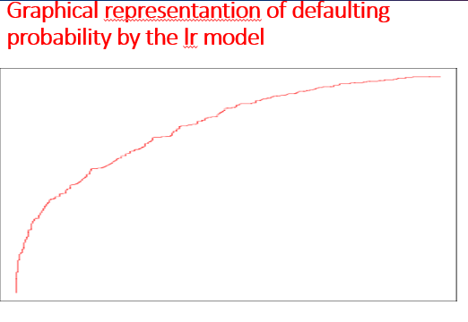
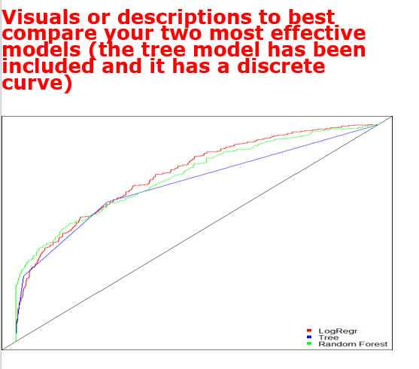
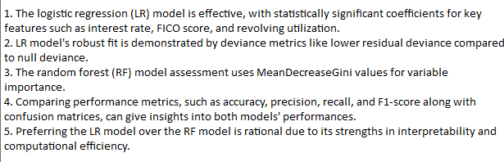
Continuation…
Notes:
The logistic regression (LR) model stands out for its effectiveness, supported by statistically significant coefficients, particularly in key features like interest rate (int.rate), FICO score, and revolving utilization (revol.util) with substantial impact, indicated by significant coefficients and low p-values. The model's robust fit to the data is underscored by deviance metrics, notably the substantially lower residual deviance compared to the null deviance. In contrast, the random forest (RF) model's assessment relies on MeanDecreaseGini values for variable importance. For a more direct comparison, considering performance metrics such as accuracy, precision, recall, and F1-score, along with the examination of confusion matrices on the test set, would provide insights into the models' performances in terms of true positives, true negatives, false positives, and false negatives. The decision to prefer the LR model over the RF model is rationalized by specific numerical comparisons, emphasizing the LR model's strengths in interpretability and computational efficiency.

Slide 6
Objectives
Model Selection
Minimize false negative rate
Maximize AUC
Optimization
Balance the maximization of:
Return on Investment (ROI)
Market Share
Profit
Emphasis on profitability given we are dealing with a mature industry
Factors into consistent returns to stakeholders

Slide 7
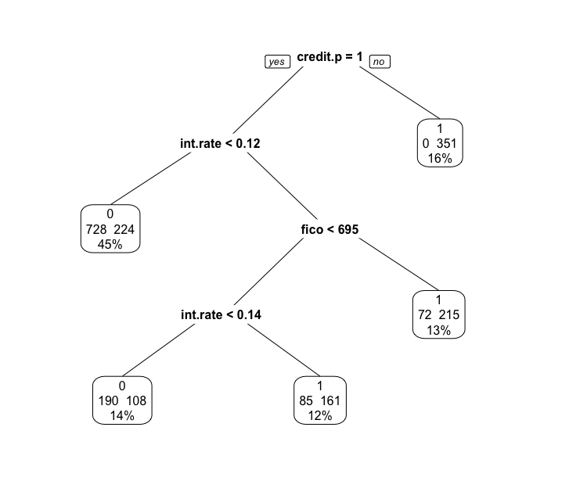
Original Tree Model Results
We predicted the binary decision of default as a function of the interest rate, credit policy and fico score.
Credit policy is the root node; having it accounts for 84% of the tree’s predictive capabilities which are broken down by interest rate- and fico-derived nodes

Slide 8
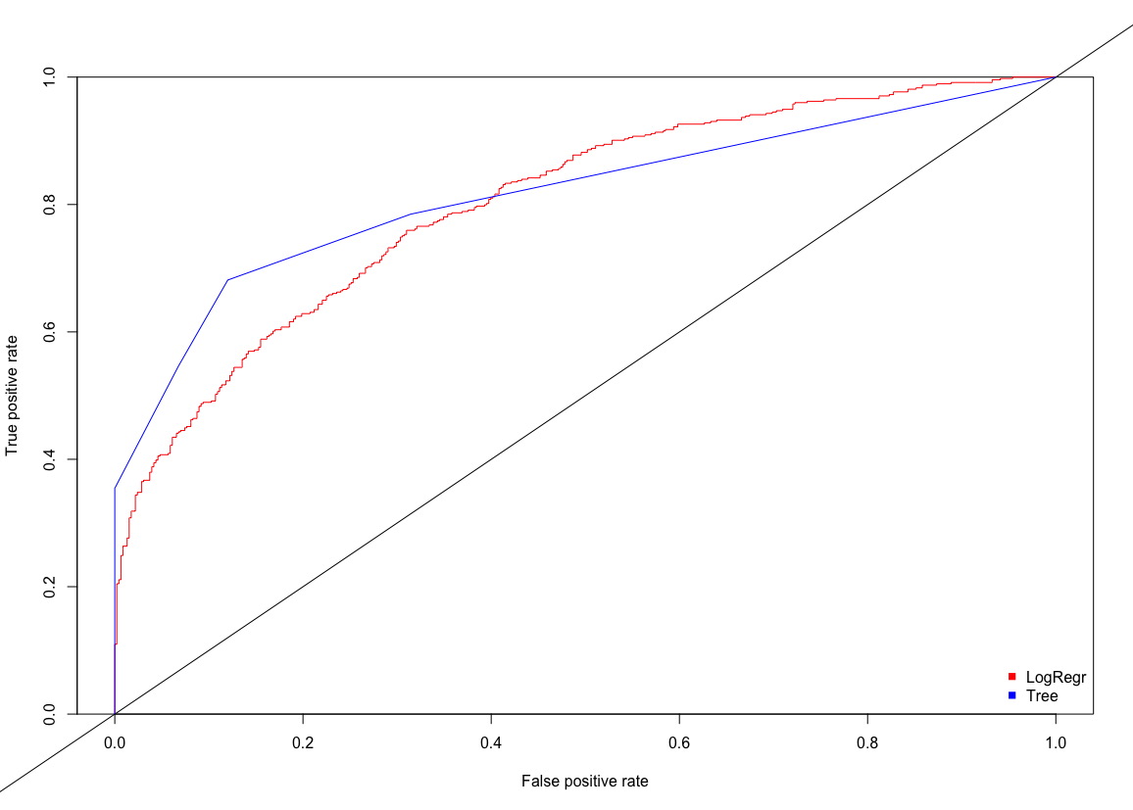
AUC Analysis – Original Tree Model & Logistic Regression
The initial KPI used in comparing our tree model to the logistic model is AUC.
Based off our AUC scale, both models fall within the “good” category within a small margin (0.8-0.9), however the tree model performs slightly better.

Slide 9
Counterfactual Analysis – Original Tree Model and Logistic Regression
Our counterfactual analysis reveals a more significant difference in performance between the models.
Through our analysis, we observe an approximately 2% false negative rate of the tree model.
Therefore, the logistic model significantly outperforms the tree model despite disproportionately lower SUC.
Tree counterfactual analysis (~12% false negative rate):
FALSE TRUE
0 4206 3839
1 572 961
Logistic counterfactual analysis (~10% false negative rate):
FALSE TRUE
0 4582 3463
1 519 1014

Slide 10
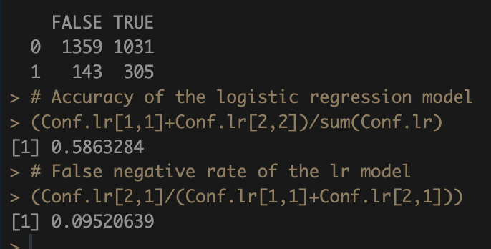
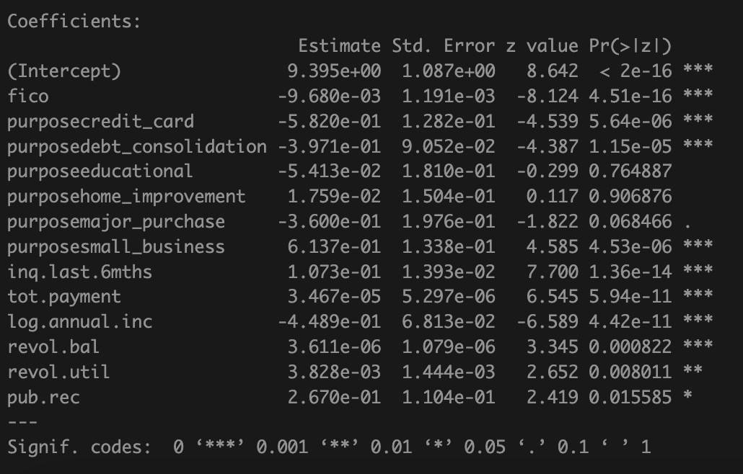

Model Comparison and Selection – Logistic (Rev.)

Slide 11
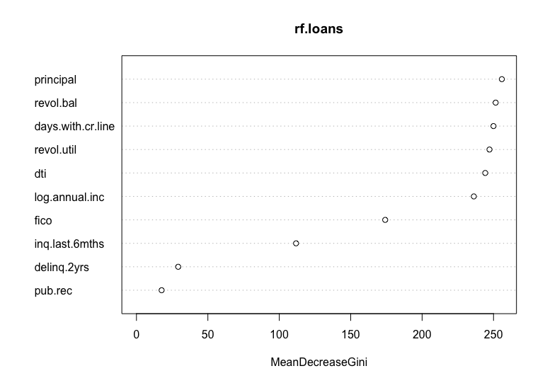
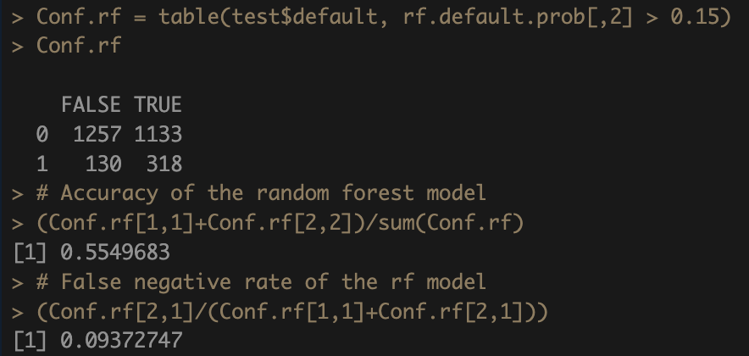

Model Comparison and Selection – Random Forest
***
***

Slide 12
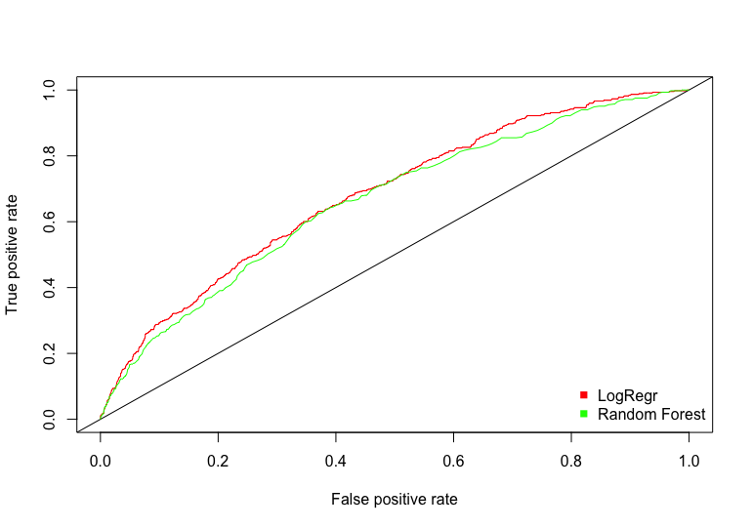
Model Comparison and Selection
False Negative Rate:
9.52% (Logistic Regression)
9.37% (Random Forest)
AUC:
68.23% (Logistic Regression)
66.25% (Random Forest)

Slide 13
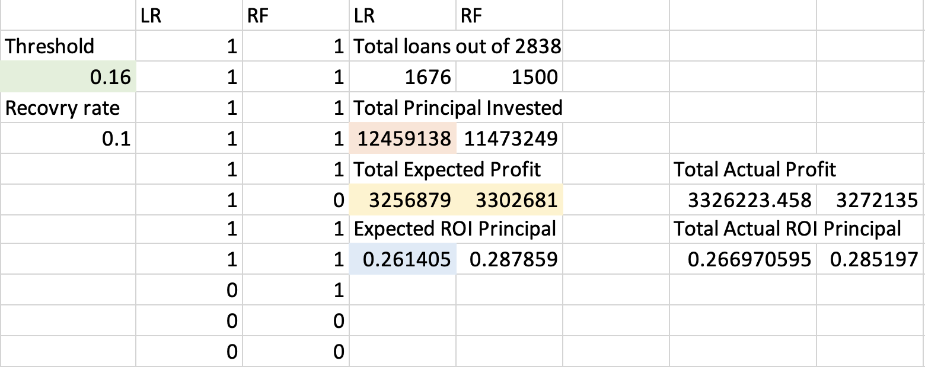
Optimization Model Description
Optimal Threshold: 16%
A 16% threshold is not only market-realistic – it also maximizes total expected profit from rates between 0 and 16%.

Slide 14
Conclusion
Model Selection
Given comparatively slight difference in the false negative rates, move forward with the revised logistic regression model given significantly higher AUC scoring.
Model Optimization
Move forward with a 16% threshold to maximize profitability (with market share and ROI as ancillary to this optimization maximization).

